Slide 1
MICROSOFT- CYBERSECURITY INCIDENT GRADE CLASSIFICATION

Slide 2
Project Summary
In today’s rapidly evolving threat landscape, Security Operation Centers (SOCs) face an overwhelming volume of cybersecurity incidents, making efficient triage and response increasingly critical. As a data scientist at Microsoft, your mission is to enhance the effectiveness of SOCs by building an intelligent classification model that accurately predicts the triage grade of security incidents.
Leveraging the comprehensive GUIDE dataset, the objective is to develop a machine learning model capable of categorizing incidents into one of three classes:
True Positive (TP) – Legitimate security threats.
Benign Positive (BP) – Non-malicious incidents that appear suspicious.
False Positive (FP) – Alerts triggered incorrectly or without real threats.
The aim is to integrate this model into guided response systems, equipping SOC analysts with context-rich, actionable insights that streamline incident response and reduce investigation time. Ultimately, this solution will contribute to a proactive and resilient security infrastructure across enterprise environments.

Slide 3
Dataset Description
The project utilizes the GUIDE dataset, a rich and complex collection of cybersecurity incident data designed to simulate real-world threats and responses in enterprise environments.
Some of the features in data are:
Id: Unique identifier for each record.
OrgId: Identifier for the organization affected by the incident.
IncidentId: Unique identifier for the incident involving one or more alerts.
AlertId: Unique ID of the specific alert.
Timestamp: Date and time when the alert was generated.
DetectorId: ID of the system or rule that triggered the alert.
AlertTitle: Encoded title or name of the alert.
Category: Category of the alert (e.g., Malware, Phishing).
MitreTechniques: MITRE ATT&CK techniques associated with the alert

Slide 4
IncidentGrade: Target variable – TP (True Positive), BP (Benign Positive), or FP (False Positive).
ActionGrouped: High-level summary of actions taken in response to the alert.
ActionGranular: Detailed actions or operations carried out.
EntityType: Type of entity involved (User, Device, etc.).
EvidenceRole: Role of the evidence in supporting the alert.
DeviceId: ID of the device on which the incident occurred.
Sha256: Encoded file hash involved in the alert.
IpAddress: IP address associated with the incident.
Url: Encoded representation of the URL linked to the alert.
AccountSid: Security Identifier (SID) of the account involved.
AccountUpn: User Principal Name of the account.
AccountObjectId: Unique ID of the user account.
AccountName: Encoded representation of the user’s name.
DeviceName: Encoded name of the affected device.
NetworkMessageId: Identifier for network-level message related to the alert.
EmailClusterId: Cluster ID for related email alerts (if applicable).

Slide 5
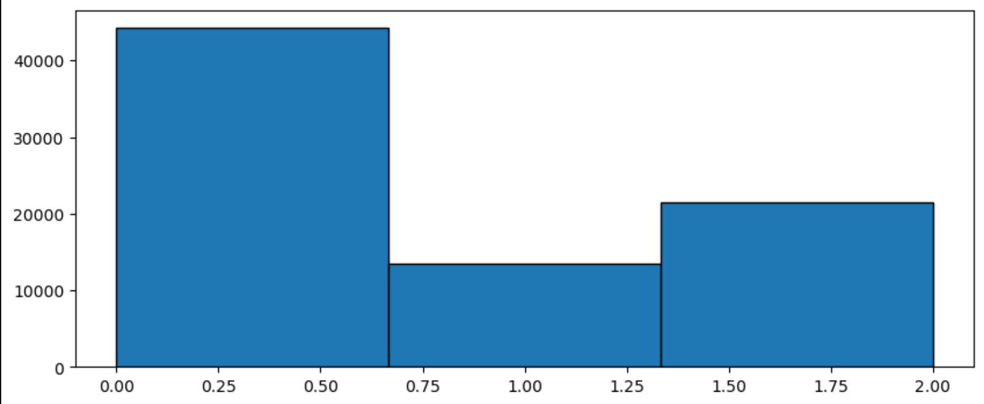
Target Variable
IncidentGrade is the target variable in this data with three values
Bening Positive(BP) -
True Positive(TP) -
False Positive(FP) –
chart

Slide 6
Data Exploration
Data Loading
The training and testing datasets were loaded using the Pandas library, which offers efficient and flexible data handling capabilities. Given the large size and high dimensionality of the data, initial loading and inspection required significant memory and processing power.
Data Summary
After loading the dataset, a comprehensive summary was conducted using pandas methods such as .info(), .describe(), and .isnull().sum() to understand the structure, data types, and completeness of the dataset.
Data Understanding
The data is further understood with visualizations and also using pandas methods and some insights such as nulls, duplicates and distributions are understood.

Slide 7
Cleaning Null Values
Dropping columns with null values more than 50%
Columns with null values more that 50% could make the model weak so these columns are removed from the dataset
Cleaning null values:
Null values are cleaned using some methods like .mean(), .median(), .mode()
Why .mean() and .median()?
Mean returns the average and median returns the middle value. These methods are used where the values in columns are continuous so that the null values are filled with average value.
Why .mode()?
Mode returns the value which is mostly appeared. This method is useful for categorical variables.

Slide 8
Encoding Categorical Variables
Encoding
Encoding is the process of converting categorical data (text or labels) into a numerical format so that machine learning algorithms can interpret and process it effectively.
Encoding methods
There are three types of methods (i) LableEncoder (ii) OneHotEncoder (iii) Ordinal Encoding.
Here LabelEncoding is used, this method
Sorts the unique values in ascending order
Assigns numbers to the values
OneHotEncoding is not used because it will increase the number of features so that the model may become weak.

Slide 9
Cleaning Outliers
Outliers are data points that are significantly different from most other values in a dataset, often indicating errors or rare events.
Disadvantage of outliers is that they can distort the results of data analysis and modeling, leading to inaccurate conclusions or poor model performance.
Interquartile Range (IQR) is used to clean outliers. The methods involved in outliers are
Calculating the Q1 and Q3 value, with a quantile value for Q1 as 0.25 and quantile value for Q3 as 0.75.
Calculating the IQR = Q3 – Q1
Setting up scaling factor – 1.5
Calculating the lower bound and upper bound with the formula,
Lower bound = Q1 – 1.5 * IQR
Upper bound = Q3 + 1.5 * IOR
Dropping the data lower than the lower bound and greater than upper bound.

Slide 10
Feature Engineering
As part of the feature engineering process, the ‘Timestamp’ column—which initially contained datetime information in string format—was transformed into more meaningful and usable components. These steps were taken
Date: Captures the exact day an incident occurred.
Month: Useful for identifying monthly trends or seasonality in attacks.
Year: Helps in grouping incidents over years and understanding long term patterns.
Hour: Important for detecting time-of-day attack patterns.
This features are created using datetime module.
Feature Scaling:
Feature Scaling is done using MinMaxScaler module in Sklearn module
Feature Scaling makes the values of features of the values under a certain range.

Slide 11
Data Preprocessing
The data preprocessing phase focused on preparing the dataset for modeling by ensuring it was clean, consistent, and in a machine-readable format. Key steps included:
Handling Missing Values: Columns with missing or null values were either filled using appropriate strategies (e.g., median imputation) or dropped based on their significance and proportion of missing data.
Encoding Categorical Features: Categorical variables were transformed into numerical format using techniques such as Label Encoding and One-Hot Encoding to make them suitable for machine learning algorithms.
Datetime Transformation: The Timestamp feature was decomposed into date, month, hour, year features to capture patterns.
As a result of preprocessing, a clean and structured dataset was obtained, ready for model training. These steps improved data quality and helped the model learn more effectively from both categorical and numerical features.

Slide 12
Visualization
To gain a deeper understanding of the dataset and uncover hidden patterns, data visualization techniques were employed. Visualizations provided critical insights into class distributions, feature correlations, and categorical trends, helping guide further preprocessing and modeling steps.
Libraries Used here are Matplotlib and Seaborn. These steps are performed
The amount of values in categorical features are visualized using histplot
The numerical features are visualized using kde plot
Outliers are visualized using bar plots and found that there are very less outliers in the data.
The relation between features are visualized using correlation heatmap, the relationship is taken for a reference.

Slide 13
Model Building
Model Building
After preprocessing, the cleaned dataset was used to train machine learning models aimed at predicting the triage grade of cybersecurity incidents (True Positive, False Positive, Bening Positive). Various classification algorithm was were explored.
Data Splitting
Split the data into training and validation set to train and evaluate the model performance.
In train-validation split the data is split into 80% for training and remaining 20% for validation.
With random state the split is random so sequence of values in the data can be avoided.
Train-validation split also maintains the balance between the classes.

Slide 14
Model Selection and Training
Logistic Regression - Logistic Regression is a supervised machine learning algorithm used for classification tasks, which models the probability of a target variable belonging to a particular class using a logistic (sigmoid) function.
Random Forest Classifier - Random Forest Classifier is an ensemble learning algorithm that builds multiple decision trees and combines their outputs to improve accuracy and reduce overfitting, making it highly effective for classification tasks.
Decision Tree Classifier - Decision Tree Classifier is a supervised learning algorithm that splits data into branches based on feature values, forming a tree-like structure to make decisions and classify outcomes.
K Neighbor Classifier - K-Nearest Neighbors (KNN) is a simple algorithm that classifies data points based on the majority class of their k closest neighbors.
XGBoost - A powerful algorithm that handles large datasets efficiently.

Slide 15
Model Metrics
Model metrics are measurements used to evaluate how well a machine learning model performs, based on its predictions compared to actual outcomes.
Metrics Used:
Accuracy: Presents the Overall Accuracy.
F1-score: Presents how many positive predictions were correct.
Precision: Presents how well model predicts actual positives.
Recall: A balanced metric that treats all classes equaly.
Model Evaluation and Tuning:
Model’s Performance is evaluated using cross-validation and optimized using hyperparameter tuning with “Grid Search CV” algorithm.
Grid Search CV returned with accuracy of 82% on random forest classifier.

Slide 16
Model Performance
Performance of test size data based on weighed average.
Model | Accuracy | F1-Score | Precision | Recall
Logistic Regression | 0.55 | 0.40 | 0.31 | 0.55
Random Forest Classifier | 0.65 | 0.58 | 0.77 | 0.65
Decision Tree Classifier | 0.70 | 0.66 | 0.75 | 0.70
K Neighbor Classifier | 0.58 | 0.57 | 0.56 | 0.58
XGBoost | 0.91 | 0.91 | 0.91 | 0.91
Grid Search | 0.82 | 0.81 | 0.84 | 0.82
Overall, the Performance of XGBoost model is better than all the other models with accuracy 91%.
The Grid Search and Decision tree also performed well but the output doesn’t meet the requirement.

Slide 17
Result with GUIDE_test.csv data
Performance when GUIDE_test data is passed in XGB model
Model | Accuracy | F1-Score | Precision | Recall
XGBoost | 0.86 | 0.86 | 0.86 | 0.86
XGBoost which performed well with 91% accuracy was again tested with the test data “GUIDE_Test.csv”, so that we could check the model’s performance on new and unseen data.
The model performed well with accuracy of 86% which is a good performance.
From this we can find that the model performs well but the accuracy is slightly dropped on new data.
Key Outcomes:
XGBoost Performed well, achieving accuracy of 91% and weighted-avg f1-score of 91% and 86% on new test data.

